Slide 1
Custom Lineage Creator
(with fuzzy matching)
Prototype

Slide 2
What are we trying to do?
If moving data from one source to another, want to be able to quickly create that custom lineage. CDGC now has some of this built in, but as of this writing, it only support relational sources, and does not allow fuzzy matching
Allow a config to sit out size the product (divorced from Ref ID’s) to communicate the sources and targets
Allow for Regex / wildcards if needed
Allow for fuzzy matching, and provide a threshold for when to match
No API’s required. Just an Export file of Technical Datasets and Elements

Slide 3
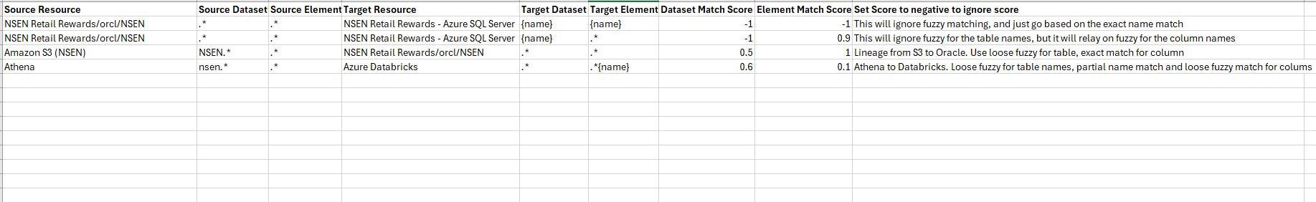
Configure with config.csv
Specify just the Resource name, or the Resource name and additional information, up to the “schema”
Specify just the Resource name, or the Resource name and additional information, up to the “schema”
Specify Fuzzy Matching minimum score for the Dataset / Element (for matching the sources to targets)
1.0 is a perfect match. 0.0 is no match at all
Setting to a negative number, means that it will ignore fuzzy matching altogether, and simply rely on the name matching
Setting to a number greater than 1 will disable the match completely
Source Dataset name, or a regex wildcard.
Same goes for the Elements
Specify the specific dataset / element name
OR name the name based on the source dataset / element
Use {name} as a token for the source name

Slide 4
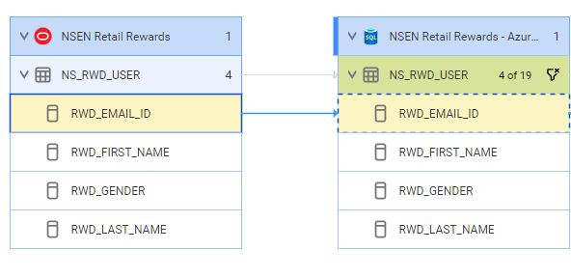
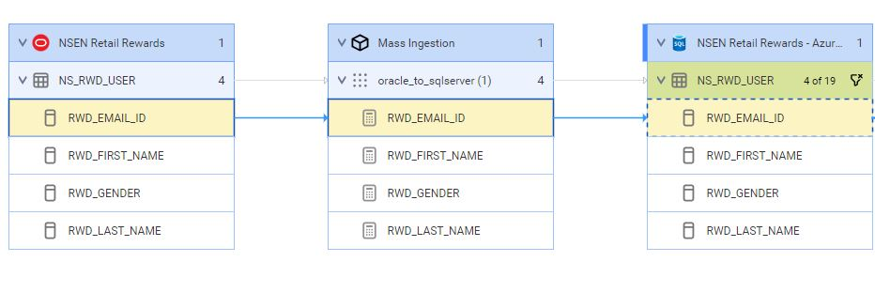
ETL Configuration (optional)
Optionally, you can configure the script to create custom sources to act an ETLs to be between the source and target. The script will create a custom ETL source for you and build the lineage. For example:
Example of simple lineage:
Example of lineage with a custom ETL:

Slide 5
ETL Configuration (optional)
If including a custom ETL, add additional information in the config file:
ETL Resource Name. The Resource Name for the ETL.
ETL Path. Path that leads to the actual ETL logic separated by “/”. This might include projects, folders, etc.
ETL Path Types. The full class types for the above path separated by “/”.
ETL Dataset Type. The full class type for the “dataset” portion of the ETL. This will be the object included in lineage
ETL Dataset Name. The name for the “dataset” portion of the ETL. This will be the object included in lineage
ETL Element Type. The full class type for the “element” portion of the ETL. This will be the object included in lineage
ETL Element Name. The name for the “element” portion of the ETL.
Tokens:
{s_dataset}: Source Dataset
{t_dataset}: Target Dataset
{s_element}: Source Element
{t_element}: Target Element
{name}: Source dataset/element (context based)
Examples:

Slide 6
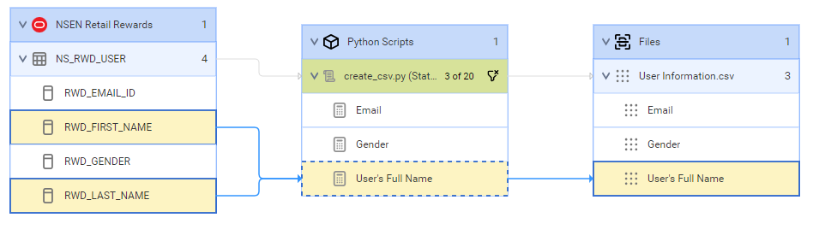
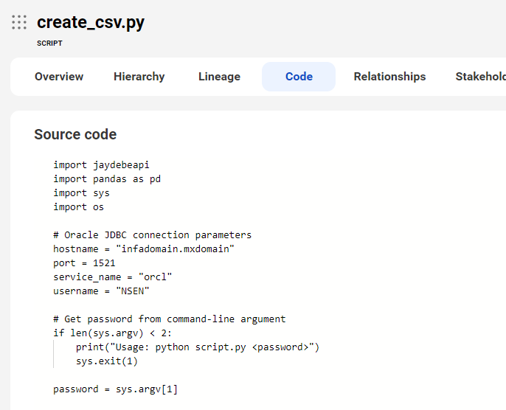
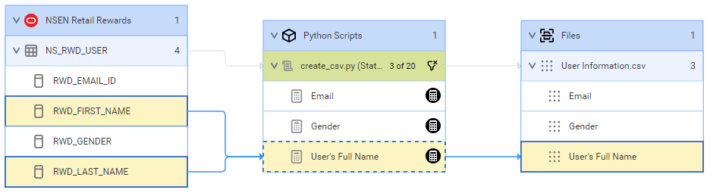
ETL Configuration (optional)
Optionally, you can configure the script to add additional attributes to the ETL custom sources. With that you can add descriptions, source code, calculations and more:
Example of lineage with a custom ETL (using the script model):
Example of custom script with source code:
Example of lineage with a custom ETL with attribute for expression (using the script model):

Slide 7
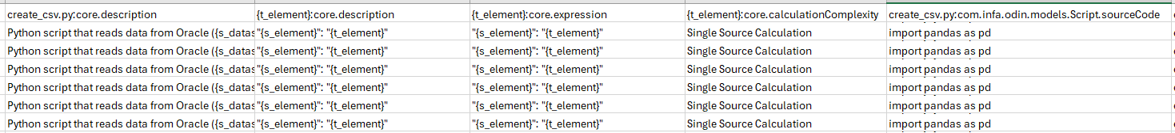
ETL Configuration (optional)
Extra Fields can be included, in case there are specific attributes you want to provide.
These object names, and values can contain tokens.
<object name>:<object attribute>. Value for the specified attribute
Examples:

Slide 8
ETL Configuration (considerations)
Things to note about the ETL :
The script uses no APIs. In order to to get the templates, the script needs a copy of the metamodel (json) and template (zip) placed in the “templates” folder
If the ETL Name entered does not exist, it will give the logic to create it, but it won’t have the ID needed for the lineage portion. It will but a “placeholder” in the links.csv file. I would suggest you manually create the resource (of the same name), and don’t run a scan. This will produce the ID that will be used.

Slide 9
Usage
Things to note about the ETL :
(optional) If you’re going to be using a new Custom Source, create the custom source within MCC (using the exact name you’ll use. For the Zip file, provide any zip file (as a placeholder), and do not run the scan. (This will create the resource, and generate a unique ID for the resource, that the script will use for lineage)
(optional) If you’re going to using a Custom Source, download the metamodel (json) and the metadata template (zip) from MCC, and place these files in the “templates” directory. (for convenience, included are the files required for IICSv2)
Within CDGC, run a search for “Resources”. Export the results. When completes, you’ll either have an excel (xlsx) or a zip file. Whichever it is, save it in the same directory as the python script.
Modify the config.csv (or other csv filename) file for your information.
(if first time running) Run pip to get the required libraries:
Execute the script (if using config other than config.csv, specify that file. Examples:
From within MCC, create a custom resource and use the lineage_<timestamp>.zip for the lineage
From within MCC, create a custom resource and use the <Resource_Name>_<timestamp>.zip for the ETL
pip install pandas datetime openpyxl
python custom_lineage_creator.py python3 custom_lineage_creator.py python custom_lineage_creator.py config_with_etl.csv

Slide 10
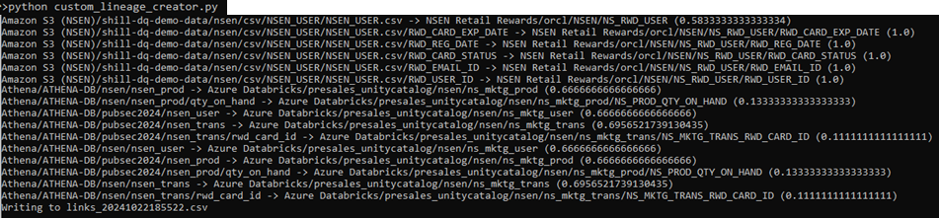
Output
Python will look for the latest Excel or zip file in the same directory.
Python will look for the config.csv in the same directory (if config file not specified)
Will display the lineage that it’s creating
Will display the match score for the dataset / element
Will write the lineage information to links_<timestamp>.csv within the “links” directory
Will write the lineage information to lineage_<timestamp>.zip within the “links” directory
Will write the ETL Resource information to <Resource Name>_<timestamp>.zip within the “resources” directory

Slide 11
Thank You
Questions / Issues / Suggestions:
Scott Hayes
shayes@informatica.com

